Slide 1
Introduction to AI

Slide 2
Course Objective
Course Objectives:
Provide an overview of Artificial Intelligence and its applications
Develop the ability to understand and apply data analysis on real world data
Provide an overview of Machine Learning
Introduce the cutting edge technologies and the ethical guidelines

Slide 3
Course Outcomes
 | Course Outcomes
CO1 | Understand the basic concepts of Artificial Intelligence
CO2 | Understand the principles of AI and its life cycle
CO3 | Apply the concepts of data analysis in real world scenario
CO4 | Identify the characteristics of machine learning that makes it useful to solve real-world problems
CO5 | Identify applications of AI in relevant disciplines
CO6 | Understand the latest trends in AI and ethical issues

Slide 4
Syllabus
Unit-1 Introduction to AI 4 hours
Introduction to Artificial Intelligence, Foundations of AI, History of AI, AI Games, Agents and Environment, Risk and Benefits of AI
Unit-2 Principles of AI 6 hours
Knowledge Representation, Problem Solving, Searching and its Strategies, Heuristic Search, AI Project Cycle, Problem Scoping, Data Acquisition, Data Exploration, Modeling
Unit-3 Data Analysis 6 hours
Sort, Filter, Conditional Formatting, Charts, Pivot Tables, Tables, What if Analysis, Solver, Descriptive Statistics, Correlation, Regression, Introduction to Programming Languages for AI

Slide 5
Syllabus
Unit-4 Introduction to Machine Learning 5 hours
Introduction to Machine Learning, Types of Learning, Use of Probability and Statistics in AI, Data Mining and Analysis Techniques
Unit-5 Applications of AI 5 hours
AI applications in Agriculture, Climate, Healthcare, Transport, Automotive Industry, Civil Engineering, Education, Robotics, Finance, Law and Legal practice, Media and Entertainment, Data Security, Tourism
Unit-6 AI in Practice 4 hours
The advances and the latest trends in AI, Discussion on State of the Art in AI, Limits of AI, Ethics of AI, Case studies

Slide 6
Text Book
Norvig, Peter, and Russell, Stuart Jonathan. Artificial intelligence : a modern approach. United Kingdom, Pearson, 2016.
Bishop, Christopher M.. Pattern Recognition and Machine Learning. Switzerland, Springer New York, 2016.

Slide 7
Introduction to AI
Artificial Intelligence is composed of two words Artificial and Intelligence, where Artificial defines "man-made," and intelligence defines "thinking power", hence AI means "a man-made thinking power.
"It is a branch of computer science by which we can create intelligent machines which can behave like a human, think like humans, and able to make decisions."

Slide 8
Goals of Artificial Intelligence
Replicate human intelligence
Solve Knowledge-intensive tasks
An intelligent connection of perception and action
Building a machine which can perform tasks that requires human intelligence such as:
Proving a theorem
Playing chess
Plan some surgical operation
Driving a car in traffic
Creating some system which can exhibit intelligent behavior, learn new things by itself, demonstrate, explain, and can advise to its user.

Slide 9
Why Artificial Intelligence?
With the help of AI, you can create such software or devices which can solve real-world problems very easily and with accuracy such as health issues, marketing, traffic issues, etc.
With the help of AI, you can create your personal virtual Assistant, such as Cortana, Google Assistant, Siri, etc.
With the help of AI, you can build such Robots which can work in an environment where survival of humans can be at risk.
AI opens a path for other new technologies, new devices, and new Opportunities.

Slide 10
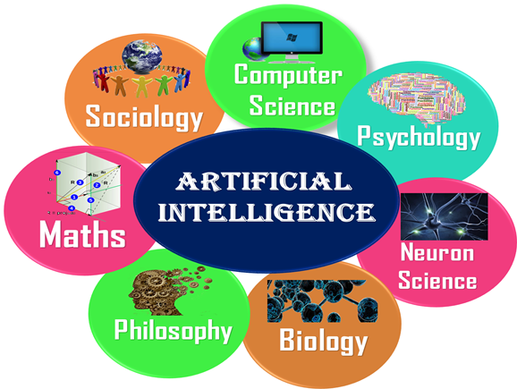
Comprises to Artificial Intelligence
Intelligence is an intangible part of our brain which is a combination of Reasoning, learning, problem-solving perception, language understanding, etc.

Slide 11
Advantages of Artificial Intelligence
High Accuracy with less errors: AI machines or systems are prone to less errors and high accuracy as it takes decisions as per pre-experience or information.
High-Speed: AI systems can be of very high-speed and fast-decision making, because of that AI systems can beat a chess champion in the Chess game.
High reliability: AI machines are highly reliable and can perform the same action multiple times with high accuracy.
Useful for risky areas: AI machines can be helpful in situations such as defusing a bomb, exploring the ocean floor, where to employ a human can be risky.
Digital Assistant: AI can be very useful to provide digital assistant to the users such as AI technology is currently used by various E-commerce websites to show the products as per customer requirement.
Useful as a public utility: AI can be very useful for public utilities such as a self-driving car which can make our journey safer and hassle-free, facial recognition for security purpose, Natural language processing to communicate with the human in human-language, etc.

Slide 12
Classification of AI
Weak artificial intelligence: A type of artificial intelligence with a design for a personal assistant, customer relationship, video games, and questionnaires known as weak artificial intelligence. It consists of a small algorithm and data source. The algorithm and data source related to the data associated with the service industry some of the weak AI examples are – a.Amazon Alexa b. Railways Disha c. Apple’s Siri.

Slide 13
Classification of AI
Strong Artificial Intelligence: It is a system that carries on the task directly performed by humans like vehicle driving. This type of task is more complex and considered under a complicated system.
They are program to handle situations in which the decision may be situational changes or unpredicted these kinds of systems developed under strong AI and testing of these systems very difficult but very useful for human beings.
This categorization of AI able to replace the manual human operative task by a programmed machine. These machines today most popularly available with an intelligent system such as robots, which treated as the same rights as humans.

Slide 14
HISTROY of AI

Slide 15
Year | Milestone / Innovation
1923 | Karel Čapek play named “Rossum's Universal Robots” (RUR) opens in London, first use of the word "robot" in English.
1943 | Foundations for neural networks laid.
1945 | Isaac Asimov, a Columbia University alumni, coined the term Robotics.
1950 | Alan Turing introduced Turing Test for evaluation of intelligence and published Computing Machinery and Intelligence. Claude Shannon published Detailed Analysis of Chess Playing as a search.

Slide 16
1956 | John McCarthy coined the term Artificial Intelligence. Demonstration of the first running AI program at Carnegie Mellon University.
1958 | John McCarthy invents LISP programming language for AI.
1964 | Danny Bobrow's dissertation at MIT showed that computers can understand natural language well enough to solve algebra word problems correctly.
1965 | Joseph Weizenbaum at MIT built ELIZA, an interactive problem that carries on a dialogue in English.
1969 | Scientists at Stanford Research Institute Developed Shakey, a robot, equipped with locomotion, perception, and problem solving.

Slide 17
1973 | The Assembly Robotics group at Edinburgh University built Freddy, the Famous Scottish Robot, capable of using vision to locate and assemble models.
1979 | The first computer-controlled autonomous vehicle, Stanford Cart, was built.
1985 | Harold Cohen created and demonstrated the drawing program, Aaron.
1990 | Major advances in all areas of AI − Significant demonstrations in machine learning Case-based reasoning Multi-agent planning Scheduling Data mining, Web Crawler natural language understanding and translation Vision, Virtual Reality Games
1997 | The Deep Blue Chess Program beats the then world chess champion, Garry Kasparov.
2000 | Interactive robot pets become commercially available. MIT displays Kismet, a robot with a face that expresses emotions. The robot Nomad explores remote regions of Antarctica and locates meteorites

Slide 18
Alan Turing Test
In 1950, Alan Turing introduced a test to check whether a machine can think like a human or not, this test is known as the Turing Test.
In this test, Turing proposed that the computer can be said to be an intelligent if it can mimic human response under specific conditions.
Turing Test was introduced by Turing in his 1950 paper, "Computing Machinery and Intelligence," which considered the question, "Can Machine think?"

Slide 19
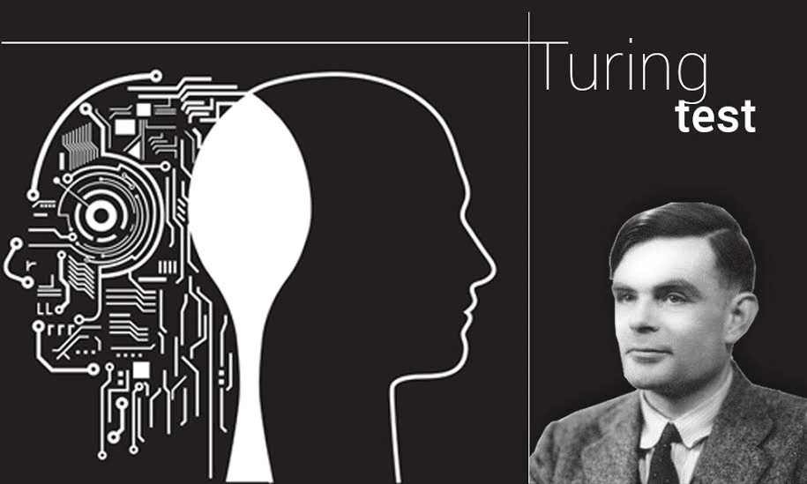
Turing Test

Slide 20
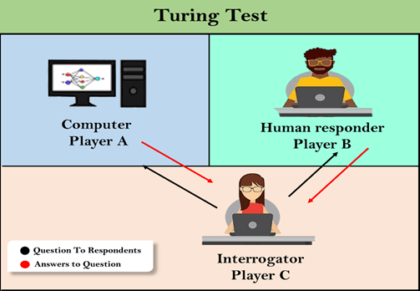
Turing Test

Slide 21
AI in Gaming
AI in gaming refers to responsive and adaptive game experiences.
These AI-powered interactive experiences are usually generated via non-player characters, or NPCs, that act intelligently or creatively, as if controlled by a human game-player.
AI is the engine that determines an NPC’s behavior in the game world.

Slide 22
Game Agents
Most AI focuses around game agent
think of agent as NPC, enemy, ally or neutral
Complete Loops: sense-think-act cycle
Acting is event specific, so talk about sense and think first, then a bit on act
Sense
Think
Act

Slide 23
Game Agents – Sensing (1 of 2)
Gather current world state: barriers, opponents, objects, …
Needs limitations: avoid “cheating” by looking at game data
Typically, same constraints as player (vision, hearing range, etc.)
Vision
Can be quite complicated (CPU intensive) to test visibility (ie- if only part of an object visible)
Compute vector to each object
Check magnitude (ie- is it too far away?)
Check angle (dot product) (ie- within 120° viewing angle?)
Check if obscured. Most expensive, so do last.

Slide 24
Game Agents – Sensing (2 of 2)
Hearing
Ex- tip-toe past, enemy doesn’t hear, but if run past, enemy hears (stealth games, like Thief)
Implement as event-driven
When player performs action, notify agents within range
Rather than sound reflection (complicated) usually distance within bounded area
Can enhance with listen attributes by agent (if agent is “keen eared” or paying attention)
Communication
Model sensing data from other agents
Can be instant (ie- connected by radio)
Or via hearing (ie- shout)
Reaction times
Sensing may take some time (ie- don’t have agent react to alarm instantly, seems unrealistic)
Build in delay. Implement with simple timer.

Slide 25
Game Agents – Thinking (1 of 3)
Evaluate information and make decision
As simple or elaborate as required
Generally, two ways:
Pre-coded expert knowledge
Typically hand-crafted “if-then” rules + “randomness” to make unpredictable
Search algorithm for best (optimal) solution
Ex- MinMax

Slide 26
Game Agents – Thinking (2 of 3)
Expert Knowledge
Finite State Machines, decision trees, … (FSM most popular, details next)
Appealing since simple, natural, embodies common sense and knowledge of domain
Ex: See enemy weaker than you? → Attack. See enemy stronger? → Go get help
Trouble is, often does not scale
Complex situations have many factors
Add more rules, becomes brittle
Still, often quite adequate for many AI tasks
Many agents have quite narrow domain, so doesn’t matter

Slide 27
Game Agents – Thinking (3 of 3)
Search
Look ahead and see what move to do next
Ex: piece on game board (MinMax), pathfinding (A*)
Works well with known information (ie- can see obstacles, pieces on board)
Machine learning
Evaluate past actions, use for future action
Techniques show promise, but typically too slow

Slide 28
Game Agents – Acting (1 of 2)
Learning and Remembering
May not be important in many games where agent short-lived (ie- enemy drone)
But if alive for 30+ seconds, can be helpful
ie- player attacks from right, so shield right
Implementation - too avoid too much information, can have fade from memory (by time or by queue that becomes full)

Slide 29
Game Agents – Acting (2 of 2)
Making agents stupid
Many cases, easy to make agents dominate
Ex: FPS bot always makes head-shot
Dumb down by giving “human” conditions, longer reaction times, make unnecessarily vulnerable, have make mistakes
Agent cheating
Ideally, don’t have unfair advantage (such as more attributes or more knowledge)
But sometimes might “cheat” to make a challenge
Remember, that’s the goal, AI lose in challenging way
Best to let player know

Slide 30
Agents and Environment

Slide 31
Outline
Characterization of agents and environments
Rationality
PEAS (Performance measure, Environment, Actuators, Sensors)
Environment types
Intelligent agent-view provides framework to integrate the
many subareas of AI.

Slide 32
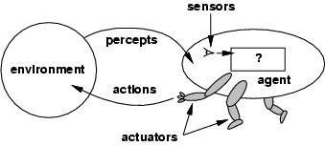
Agents
Definition: An agent perceives its environment via sensors and acts upon that environment through its actuators.

Slide 33

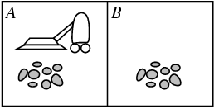
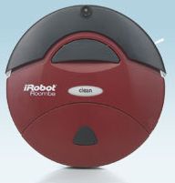
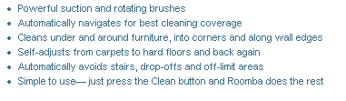
E.g., vacuum-cleaner world
Agent / Robot
Percepts: location and contents, e.g., [A, Dirty]
Actions: Left, Right, Suck, NoOp
iRobot Corporation
Founder Rodney Brooks (MIT)

Slide 34
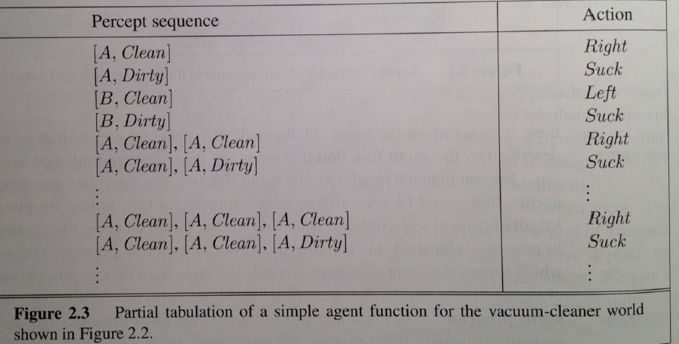
Toy example:
Vacuum world.
Percepts: robot senses it’s location and “cleanliness.”
So, location and contents, e.g., [A, Dirty], [B, Clean].
With 2 locations, we get 4 different possible sensor inputs. Actions: Left, Right, Suck, NoOp

Slide 35
An AI system is composed of an agent and its environment. The agents act in their environment. The environment may contain other agents.
What are Agent and Environment?
An agent is anything that can perceive its environment through sensors and acts upon that environment through effectors.
A human agent has sensory organs such as eyes, ears, nose, tongue and skin parallel to the sensors, and other organs such as hands, legs, mouth, for effectors.
A robotic agent replaces cameras and infrared range finders for the sensors, and various motors and actuators for effectors.
A software agent has encoded bit strings as its programs and actions.

Slide 36
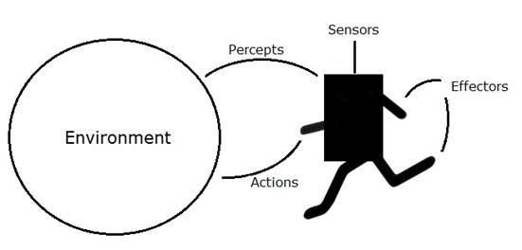
Agent Terminology
Performance Measure of Agent − It is the criteria, which determines how successful an agent is.
Behavior of Agent − It is the action that agent performs after any given sequence of percepts.
Percept − It is agent’s perceptual inputs at a given instance.
Percept Sequence − It is the history of all that an agent has perceived till date.
Agent Function − It is a map from the precept sequence to an action.

Slide 37
Properties of Environment
The environment has multifold properties −
Discrete / Continuous − If there are a limited number of distinct, clearly defined, states of the environment, the environment is discrete (For example, chess); otherwise it is continuous (For example, driving).
Observable / Partially Observable − If it is possible to determine the complete state of the environment at each time point from the percepts it is observable; otherwise it is only partially observable.
Static / Dynamic − If the environment does not change while an agent is acting, then it is static; otherwise it is dynamic.
Single agent / Multiple agents − The environment may contain other agents which may be of the same or different kind as that of the agent.

Slide 38
Properties of Environment
Accessible / Inaccessible − If the agent’s sensory apparatus can have access to the complete state of the environment, then the environment is accessible to that agent.
Deterministic / Non-deterministic − If the next state of the environment is completely determined by the current state and the actions of the agent, then the environment is deterministic; otherwise it is non-deterministic.
Episodic / Non-episodic − In an episodic environment, each episode consists of the agent perceiving and then acting. The quality of its action depends just on the episode itself. Subsequent episodes do not depend on the actions in the previous episodes. Episodic environments are much simpler because the agent does not need to think ahead.

Slide 39
Rationality
Rationality is nothing but status of being reasonable, sensible, and having good sense of judgment.
Rationality is concerned with expected actions and results depending upon what the agent has perceived. Performing actions with the aim of obtaining useful information is an important part of rationality.
What is Ideal Rational Agent?
An ideal rational agent is the one, which is capable of doing expected actions to maximize its performance measure, on the basis of Its percept sequence
Its built-in knowledge base
Rationality of an agent depends on the following −
The performance measures, which determine the degree of success.
Agent’s Percept Sequence till now.
The agent’s prior knowledge about the environment.
The actions that the agent can carry out.

Slide 40
A rational agent always performs right action, where the right action means the action that causes the agent to be most successful in the given percept sequence. The problem the agent solves is characterized by Performance Measure, Environment, Actuators, and Sensors (PEAS).
The Structure of Intelligent Agents
Agent’s structure can be viewed as −
Agent = Architecture + Agent Program
Architecture = the machinery that an agent executes on.
Agent Program = an implementation of an agent function.

Slide 41
Types of Agents
Simple Reflex Agents
Model Based Reflex Agents
Goal Based Agents
Utility Based Agents

Slide 42
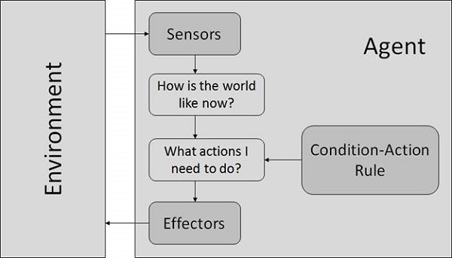
Simple Reflex Agents
They choose actions only based on the current percept.
They are rational only if a correct decision is made only on the basis of current precept.
Their environment is completely observable.
Condition-Action Rule − It is a rule that maps a state (condition) to an action.

Slide 43
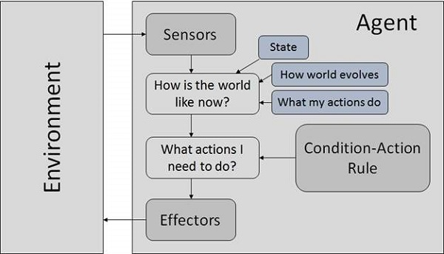
Model Based Reflex Agents
They use a model of the world to choose their actions. They maintain an internal state.
Model − knowledge about “how the things happen in the world”.
Internal State − It is a representation of unobserved aspects of current state depending on percept history.
Updating the state requires the information about −
How the world evolves.
How the agent’s actions affect the world.

Slide 44
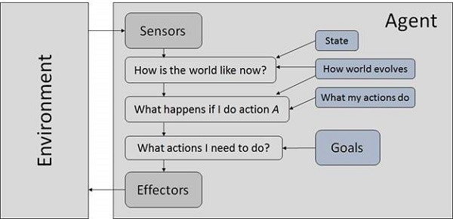
Goal Based Agents
They choose their actions in order to achieve goals. Goal-based approach is more flexible than reflex agent since the knowledge supporting a decision is explicitly modeled, thereby allowing for modifications.
Goal − It is the description of desirable situations.

Slide 45
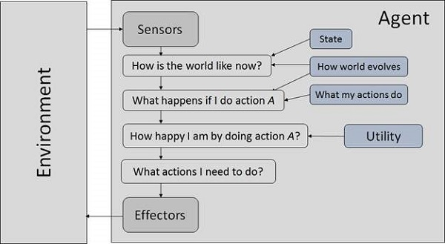
Utility Based Agents
They choose actions based on a preference (utility) for each state.
Goals are inadequate when −There are conflicting goals, out of which only few can be achieved.
Goals have some uncertainty of being achieved and you need to weigh likelihood of success against the importance of a goal.

Slide 46
RISKS and LIMITATION OF ARTIFICIAL INTELLIGENCE
Automation-spurred job loss
Privacy violations
'Deepfakes'
Algorithmic bias caused by bad data
Socioeconomic inequality
Market volatility
Weapons automatization

